Slide 1

ELASTIC CLOUD COMPUTE OVERVIEW

Slide 2
AMAZON ELASTIC CLOUD COMPUTE (EC2) Overview
What is Amazon EC2?
Amazon Elastic Compute Cloud (Amazon EC2) is a web service that provides secure, resizable compute capacity in the cloud.
Allows users to configure, setup and start a server in minutes allowing experimentation, and both vertical and horizontal scaling as required.
Before public cloud & EC2, it would take 30-90 days to buy, configure and setup a server.
Enables users to provision the exact resources required or adjust as needed
No capital expense, no capacity planning, pay as you use

Slide 3
AMAZON ELASTIC CLOUD COMPUTE (EC2) Pricing Models
On-Demand: Pay for compute capacity by per hour or per second depending on which instances you run. Generally used for ad-hoc or quick compute needs, e.g. applications being developed or tested.
Reserved Instances: Reserve compute capacity upfront to get significant discount (up to 75%) compared to On-Demand instance pricing. Terms can be either 1 year or 3 year. Used for application that are in steady state
Reserve Instances can be of two types
Standard – Reserved across the period
Convertible – Provides flexibility to use different instance types, operating systems and tenancies
Scheduled – Reserved for a recurring schedule
Spot Instances: Spot instances allow you to request spare Amazon EC2 computing capacity for up to 90% off the On-Demand price by bidding on compute resources. Used for applications that have flexible start and end times
Dedicated Hosts: A physical EC2 server dedicated for your use. Can be purchased On-Demand or reserved. Used generally when for situations where existing server-bound licenses needs to be migrated

Slide 4
AMAZON ELASTIC CLOUD COMPUTE (EC2) EC2 Instance Types
Family | Description | Use Case
A1 | Performance Optimized for scale-out workloads | Applications that run on ARM based architecture
T2 / T3 | General purpose workloads | Applications with moderate CPU use, interactive applications, small databases, dev and test stage VMs, prototypes etc.
M4/ M5 / M5a | General purpose workloads | Web and app servers, backend servers for ERP, dev environments
C4 / C5 / C5n | Compute Intensive workload | HPC, scientific modelling, video encoding, distributed analytics, machine learning, etc.
R4 / R5 / R5a | Memory Intensive workloads | High performance Databases, in-memory database, big data analytics, ERPs, etc.
X1 / X1e | Memory Intensive workloads | HPCs, SAP HANA, S/4HANA, etc.
P2 / P3 | General purpose GPU | Machine learning, cryptocurrency mining, HPC applications
G3 | Graphics Intensive GPU | 3D visualization, 3D rendering, video encoding, etc.
F1 | Field Programmable Gate Array | Big data analytics, genomics, electronic design automation, image & video processing, compression, etc.
H1 | Storage optimized instances | MapReduce based workloads, distributed file systems, log or data processing, big data workload clusters
I3 | High Speed (I/O) Storage | In-memory database, data warehousing, analytics, search
D2 | Dense Storage | Fileservers, data warehousing, Hadoop

Slide 5
AMAZON ELASTIC CLOUD COMPUTE (EC2) Elastic Block Storage (EBS)
What is EBS
Amazon Elastic Block Store (Amazon EBS) provides persistent block storage volumes for use with Amazon EC2 instances in the AWS Cloud.
Allows you to create and attach storage volumes to EC2 instances
Once attached can be configured to create a file system, run a database, or in any other manner like a HDD
Multiple EBS instances can be attached to a single EC2 instance
EBS instance is automatically replicated within its AZ to protect you from component failure
A root device volume is where the Operating System is stored

Slide 6
AMAZON ELASTIC CLOUD COMPUTE (EC2) EBS Types
EBS Volume Types
Type | Purpose | Pricing | Root Volume
General Purpose SSD (GP2) | General purpose Solid-state disk drives 3 IOPS per GB burstable to 3,000 IOPS, with up to 10,000 IOPS | Per GB-month of provisioned storage | 
Provisioned IOPS SSD (IO1) | For I/O intensive applications, e.g. large DBs or NoSQL databases Ideal if more than 10,000 IOPS is needed Can provision 20,000 IOPS per volume | Per GB-month of provisioned storage Per provisioned IOPS-month | 
Throughput Optimized HDD (ST1) | Ideal for large datasets that require cheap storage, e.g. data warehouse | Per GB-month of provisioned storage | 
Cold HDD (SC1) | Cheap storage option that requires low IOPS Typically used as a file storage or file server | Per GB-month of provisioned storage | 
Magnetic (Standard) [Previous Generation] | Cheapest storage type Typically used for workloads where data is used infrequently and low cost is important Is typically used for test and dev environments | Per GB-month of provisioned storage Per 1 million I/O request | 
EBS Snapshots are stored in S3 and costs per GB-month of data stored

Slide 7
AMAZON ELASTIC CLOUD COMPUTE (EC2) LAB 2
Create a Simple HTML Website
Create a WebServer
Create a DMZ Security Group
Create a VM
Login via SSH / Putty
Update all the packages
Install Apache WebServer
Start Apache WebServer
Create an HTML File
Display the HTML File in web browser
Delete the HTML file
Display the HTML File in browser again
Terminate the instance
Bonus Challenge: Change the EC2 instance type
Notes:
Two types of virtualization
HVM
PV
Show different pricing models
Demo termination protection
Demo types of volumes
Demo Security Group options dropdowns
CHMOD 400 EC2 key pair
Demo pricing options
Demo snapshot and AMI
sudo Su
Yum install httpd
/var/www/html
Service httpd start
Homework Lab 2: install and configure a WordPress server

Slide 8
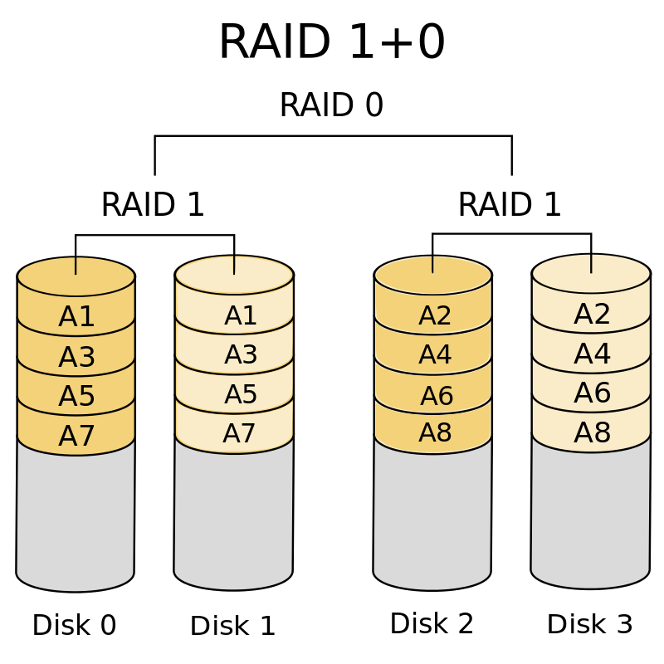
AMAZON ELASTIC CLOUD COMPUTE (EC2) RAID ARRAY
RAID = Redundant Array of Independent Disks
RAID 0: Striping, no mirroring, no redundancy, no parity
RAID 1: No Striping, Mirroring, Redundancy, no parity
RAID 5: Striping, Parity, Good for read, slow for write speed. Discouraged by Amazon
RAID 1+0 (10): Striping, Mirroring, Redundancy, no parity, Good performance
Why do you need a RAID array?
To get a higher IOPS throughput, e.g. for OLTP DBs

Slide 9
AMAZON ELASTIC CLOUD COMPUTE (EC2) LAB 3
Create a RAID Array
Create a Windows VM
Edit the Security Group and add RDP protocol
Create and EC2 instance
Select a free tier eligible Windows Server 2012 R2
Select t2.micro instance
Use defaults for Instance Details
Create 4 additional volumes (GP2 SSD) of 8 GB each, leave the root device as 30GB
Add tags
Select the DMZ that you edited
Launch the Instance
RDP into the Windows instance
Username is administrator
Click on actions – get windows password
Upload the keypair to generate the password
Use the decrypted password
Search for mstsc or Remote desktop connection in start bar
Explore the drives
Create a RAID array
Go to disk management
Delete all the volumes
Create striped volumes
This is effectively RAID 0, and the throughput is 4x the individual IOPS

Slide 10
AMAZON ELASTIC CLOUD COMPUTE (EC2) LAB 4
Create multiple EBS volume & Upgrade them
Create a new EC2 instance
Select a free tier eligible Windows Server 2012 R2
Select t2.micro instance
Use defaults for Instance Details
Create 4 volumes
8 GB GP2, 8GB Magnetic, 500 GB ST1, 500 GB SC1
Add tags
Select the DMZ
Launch the Instance
Modify the Root volume type
Go to EBS section in EC2 Console
Click on Volumes
Right Click on a Volume
Click on Modify Volume
Change the 8GB Magnetic to GP2
Increase the size of GP2 to 10 GB
Click Modify
Detach and Attach the Volumes
Go to EBS > Volumes
Detach all the 3 volumes that are not root volumes
Click on Create Volume
Check all the options, change the size to 10 GB
Create Volume
Right Click on the volume, click on Instance ID, select a running instance
Click Attach
Explore
Notes:
Can you attach the same volume to two different EC2 Instance?

Slide 11
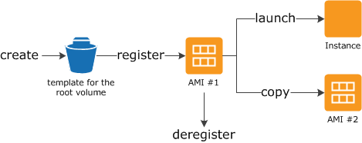
AMAZON ELASTIC CLOUD COMPUTE (EC2) Amazon Machine Image (AMI)
What is Amazon Machine Image (AMI)?
An Amazon Machine Image (AMI) provides the information required to launch an instance
An AMI must be specified while launching an instance of EC2
AMIs is created by taking a Snapshot of Root Device Volume
An AMI includes
A template for the root volume for the instance (for example, an operating system, an application server, and applications)
Launch permissions that control which AWS accounts can use the AMI to launch instances
A block device mapping that specifies the volumes to attach to the instance when it's launched
Anybody can create their own AMIs
AMIs can be copied, shared, bought or sold on AWS Marketplace
AMIs have four sources
Published by AWS
AWS Marketplace
Generated from Existing Instances
Uploaded Virtual Server using AWS Import/Export

Slide 12
AMAZON ELASTIC CLOUD COMPUTE (EC2) SNAPSHOT
What is Amazon EBS Snapshots?
Amazon EBS Volumes can be backed up to Amazon S3 by taking point-in time snapshots
Snapshots are incremental backups, which means that only the blocks on the device that have changed after your most recent snapshot are saved.
A Snapshot contains all of the information needed to restore your data (from the moment when the snapshot was taken) to a new EBS volume.
A Snapshot
Can be shared by modifying its access permission
Can be copied as well
Is constrained to the Region it was created in
Can be encrypted
Can be used to create an AMI if it is of a root volume

Slide 13
AMAZON ELASTIC CLOUD COMPUTE (EC2) LAB 5a
Create an AMI and Snapshot
Copy AMI & Snapshot
Create an WebServer
Create a VM
Login via SSH / Putty
Update all the packages
Install Apache WebServer
Start Apache WebServer
Set Apache to start at boot
Navigate to Webroot
Create an HTML File
View the website in web browser
Create the AMI
Go to Instances dashboard
Right click on the EC2 instance > Image > Create an Image
Go to Images > AMI, explore
Go to Elastic Block Storage > Snapshots, explore
Shut down the EC2 instance
Go to Images AMI,
Right click on the AMI > Launch
Create a new VM
Get the public IP and paste it in your browser
Check the website
Shut down the VM

Slide 14
AMAZON ELASTIC CLOUD COMPUTE (EC2) LAB 5b
Copy AMI & Snapshot
Go to Images > AMIs
Right click on AMI, select Copy AMI
Select the destination as a different Region
Give Name and Descriptions
Click on Copy AMI
Change the Region to the one selected while creating the AMI
Go to Images > AMIs
Right Click on the AMI, then click Launch
Launch an EC2 instance
Check the Website by using its public IP

Slide 15
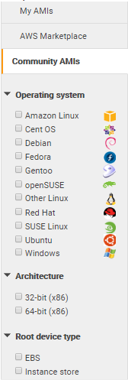
AMAZON ELASTIC CLOUD COMPUTE (EC2) AMI: Instance Store vs EBS Backed
Some Amazon EC2 instance types come with a form of directly attached, block-device storage known as the Instance Store.
Also known as Ephemeral Storage, it is temporary in nature and all the data on the volume is lost once the EC2 instance is shut down
Data on an Instance Store is not persistent and is lost when the instance stops, terminations, or hardware failures
Instance Store cannot be encrypted
Not suited for data that is valuable, long-term, or requires durability or security
AMIs that are backed by Instance Store can be found in community AMIs via filters

Slide 16
AMAZON ELASTIC CLOUD COMPUTE (EC2) Amazon Elastic File Storage (EFS)
What is Amazon Machine Image (AMI)?
Amazon Elastic File System (Amazon EFS) provides a simple, scalable, elastic file system for Linux-based workloads for use with AWS
Amazon EFS supports Network File System v4 (NFS v4)
Supported by only Linux systems, not supported with Windows based EC2 instances
Amazon EFS storage capacity is elastic, i.e. grows and shrinks as files are added or removed
Supports upto petabytes of storage and thousands of concurrent connections
Data stored across AZs, regions, and VPCs
Read after write consistency
Can also be connected with On-Premise systems using AWC Direct Connect or AWS VPN

Slide 17
AMAZON ELASTIC CLOUD COMPUTE (EC2) LAB 6
Create an EFS volume and attach to an EC2 instance
Go to Service > Storage > EFS
Click on “Create file system”
Select the AZs where mount targets needs to be created
Explore other options, leave as default
Click on Next Step
Add Tags
Choose Performance Mode & Throughput Mode
Leave Encryption & Lifecycle unchecked
Click on Next Step, then click on Create File System
Notes:
Mounting EFS
If you're using an Amazon Linux EC2 instance, install the EFS mount helper with the following command: sudo yum install -y amazon-efs-utils You can still use the EFS mount helper if you're not using an Amazon Linux instance. Learn more If you're not using the EFS mount helper, install the NFS client on your EC2 instance:
On a Red Hat Enterprise Linux or SUSE Linux instance, use this command: sudo yum install -y nfs-utils
On an Ubuntu instance, use this command: sudo apt-get install nfs-common
Mounting your file system
Open an SSH client and connect to your EC2 instance. (Find out how to connect).
Create a new directory on your EC2 instance, such as "efs". sudo mkdir efs
Mount your file system with a method listed following. If you need encryption of data in transit, use the EFS mount helper and the TLS mount option. Mounting considerations
Using the EFS mount helper: sudo mount -t efs <FS ID>:/ efs

Slide 18

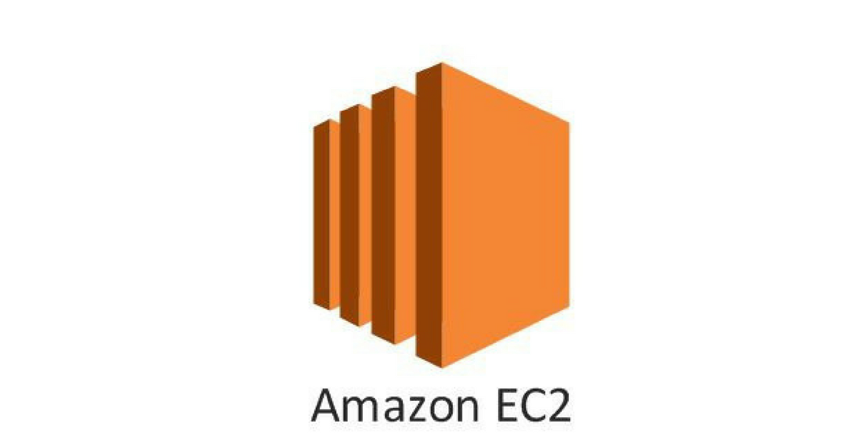
AMAZON ELASTIC CLOUD COMPUTE (EC2) Security Group
What is a Security Group?
Security group is a virtual firewall and like a firewall is used to permit incoming or outgoing traffic
Each object / instance has to be part of a security group
Incoming Traffic
Outgoing Traffic
Each security group can be configured with rules that allows traffic to and from instances
By default security groups block all inbound traffic
Security Group
More than one security group can be assigned to one instance
Security Groups are stateful
Permitted Incoming Traffic
Permitted Outgoing Traffic
Notes:
Mounting EFS
If you're using an Amazon Linux EC2 instance, install the EFS mount helper with the following command: sudo yum install -y amazon-efs-utils You can still use the EFS mount helper if you're not using an Amazon Linux instance. Learn more If you're not using the EFS mount helper, install the NFS client on your EC2 instance:
On a Red Hat Enterprise Linux or SUSE Linux instance, use this command: sudo yum install -y nfs-utils
On an Ubuntu instance, use this command: sudo apt-get install nfs-common
Mounting your file system
Open an SSH client and connect to your EC2 instance. (Find out how to connect).
Create a new directory on your EC2 instance, such as "efs". sudo mkdir efs
Mount your file system with a method listed following. If you need encryption of data in transit, use the EFS mount helper and the TLS mount option. Mounting considerations
Using the EFS mount helper: sudo mount -t efs <FS ID>:/ efs

Slide 19
AMAZON ELASTIC CLOUD COMPUTE (EC2) LAB 7
Create the Security Group
Log into AWS console
Click on EC2
Create a EC2 instance
Use Amazon Linux AMI
Select t2.micro instance
Use the default configuration for Instance Details
Use the default configuration for Storage
Add Tags
Create a Security Group – named MyDMZ
Open ports for HTTP, HTTPS, SSH to all destinations
Launch the Instance
Test the Security Group
SSH into the EC2 instance
Update the software packages
Install Apache WebServer
Start the Apache WebServer
Configure the Apache to start on boot
Navigate to Webroot
Create a html file
Add a message to HTML file
Test if the webpage is accessible from internet
Delete the HTTP rule and test again
Add the http rule again and test again
Add another security group to the instance
Notes:
Mounting EFS
If you're using an Amazon Linux EC2 instance, install the EFS mount helper with the following command: sudo yum install -y amazon-efs-utils You can still use the EFS mount helper if you're not using an Amazon Linux instance. Learn more If you're not using the EFS mount helper, install the NFS client on your EC2 instance:
On a Red Hat Enterprise Linux or SUSE Linux instance, use this command: sudo yum install -y nfs-utils
On an Ubuntu instance, use this command: sudo apt-get install nfs-common
Mounting your file system
Open an SSH client and connect to your EC2 instance. (Find out how to connect).
Create a new directory on your EC2 instance, such as "efs". sudo mkdir efs
Mount your file system with a method listed following. If you need encryption of data in transit, use the EFS mount helper and the TLS mount option. Mounting considerations
Using the EFS mount helper: sudo mount -t efs <FS ID>:/ efs

Slide 20
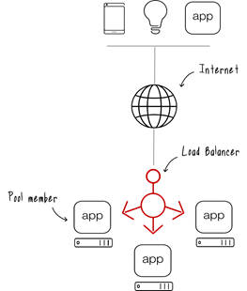
AMAZON ELASTIC CLOUD COMPUTE (EC2) Load Balancing
What is a Load Balancing
1
Load Balancing is a method used to distribute workload across a number of resources.
A Load Balancer can be a device, application, or appliance that helps in the distribution of internet traffic across servers, it is used to
2
Minimize response time
Avoid overloading a single resource
Increase Reliability and Availability
© F5
AWS Load Balancers can be of three types
3
Classic Load Balancer
1. A user send a request to a website
Network Load Balancer
2. Load Balancer Receives the request
Application Load Balancer
3. Load Balancer forwards the request to the optimal server
Load Balancers can be configured to choose optimal resource based on several algorithm as per need
Notes:
Mounting EFS
If you're using an Amazon Linux EC2 instance, install the EFS mount helper with the following command: sudo yum install -y amazon-efs-utils You can still use the EFS mount helper if you're not using an Amazon Linux instance. Learn more If you're not using the EFS mount helper, install the NFS client on your EC2 instance:
On a Red Hat Enterprise Linux or SUSE Linux instance, use this command: sudo yum install -y nfs-utils
On an Ubuntu instance, use this command: sudo apt-get install nfs-common
Mounting your file system
Open an SSH client and connect to your EC2 instance. (Find out how to connect).
Create a new directory on your EC2 instance, such as "efs". sudo mkdir efs
Mount your file system with a method listed following. If you need encryption of data in transit, use the EFS mount helper and the TLS mount option. Mounting considerations
Using the EFS mount helper: sudo mount -t efs <FS ID>:/ efs

Slide 21
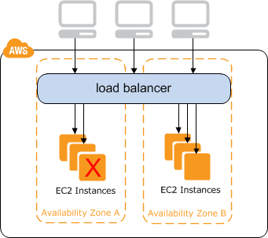
AMAZON ELASTIC CLOUD COMPUTE (EC2) Classic Load Balancer
Classic Load Balancers are sometimes also called legacy Elastic Load Balancers, are the first generation of Load Balancers in AWS.
1
Classic Load Balancers distributes incoming application traffic across multiple EC2 instances
2
Classic Load Balancers can route traffic at either Transport Layer (OSI Layer 4: TCP/SSL) or the application layer (OSI Layer 7: HTTP/HTTPS)
3
Classic Load Balancers works in the following manner
1) A user sends a request to the website / webservice
The request is sent as a HTTP packet
2) Load Balancer receives and forwards the request
Load Balancer acts as a single point of contact for all incoming requests (increasing availability))
ELB automatically scales based on the number of incoming requests (providing scalability)
Load Balancer Adds a X-Forwarded-For header and forwards the request to an EC2 Instance based on the configured algorithm
X-Forwarded-For Header provides the application with relevant metadata (providing sticky-sessions)
3) EC2 instances processes the request and sends back a response to the end user via Load Balancer
Notes:
Mounting EFS
If you're using an Amazon Linux EC2 instance, install the EFS mount helper with the following command: sudo yum install -y amazon-efs-utils You can still use the EFS mount helper if you're not using an Amazon Linux instance. Learn more If you're not using the EFS mount helper, install the NFS client on your EC2 instance:
On a Red Hat Enterprise Linux or SUSE Linux instance, use this command: sudo yum install -y nfs-utils
On an Ubuntu instance, use this command: sudo apt-get install nfs-common
Mounting your file system
Open an SSH client and connect to your EC2 instance. (Find out how to connect).
Create a new directory on your EC2 instance, such as "efs". sudo mkdir efs
Mount your file system with a method listed following. If you need encryption of data in transit, use the EFS mount helper and the TLS mount option. Mounting considerations
Using the EFS mount helper: sudo mount -t efs <FS ID>:/ efs

Slide 22
AMAZON ELASTIC CLOUD COMPUTE (EC2) Network Load Balancer
Network Load Balancers are used for cases where extreme performance is the priority
1
Network Load Balancers distributes incoming application traffic across multiple EC2 instances, microservices, and containers.
Routes traffic to a single IP address per Availability Zone and operates at Transport Layer (OSI Layer 4: TCP) capable of handling millions of requests per second
2
3
Network Load Balancers works in the following manner
1) A user sends a request to the website / webservice
The request is sent as a HTTP packet
2) Load Balancer receives and forwards the request
Load Balancer acts as a single point of contact for all incoming requests (increasing availability))
Load Balancer forwards the packet to the destination based on routing algorithm
Load Balancer acts like a NAT server and doesn’t look into the actual content of the request
3) EC2 instances processes the request and sends back a response to the end user via Load Balancer
Notes:
Mounting EFS
If you're using an Amazon Linux EC2 instance, install the EFS mount helper with the following command: sudo yum install -y amazon-efs-utils You can still use the EFS mount helper if you're not using an Amazon Linux instance. Learn more If you're not using the EFS mount helper, install the NFS client on your EC2 instance:
On a Red Hat Enterprise Linux or SUSE Linux instance, use this command: sudo yum install -y nfs-utils
On an Ubuntu instance, use this command: sudo apt-get install nfs-common
Mounting your file system
Open an SSH client and connect to your EC2 instance. (Find out how to connect).
Create a new directory on your EC2 instance, such as "efs". sudo mkdir efs
Mount your file system with a method listed following. If you need encryption of data in transit, use the EFS mount helper and the TLS mount option. Mounting considerations
Using the EFS mount helper: sudo mount -t efs <FS ID>:/ efs

Slide 23
AMAZON ELASTIC CLOUD COMPUTE (EC2) Application Load Balancer
Application Load Balancers do intelligent load balancing
1
Application Load Balancers works at the application layer and performs advanced routing that can be targeted to application architectures, microservices, and containers
Operates at Application Layer (OSI Layer 7) ideal for advanced load routing that cab be targeted at IP addresses, Lambda functions, and other microservices.
2
3
Application Load Balancers works in the following manner
1) A user sends a request to the website / webservice
The request is sent as a HTTP packet
2) Load Balancer receives and forwards the request
Load Balancer acts as a single point of contact for all incoming requests (increasing availability))
Load Balancer analyses the content of the packet and makes a the routing decision accordingly
Attaches X-Forwarded-For Header for the application with relevant metadata
3) EC2 instances processes the request and sends back a response to the end user via Load Balancer
Notes:
Mounting EFS
If you're using an Amazon Linux EC2 instance, install the EFS mount helper with the following command: sudo yum install -y amazon-efs-utils You can still use the EFS mount helper if you're not using an Amazon Linux instance. Learn more If you're not using the EFS mount helper, install the NFS client on your EC2 instance:
On a Red Hat Enterprise Linux or SUSE Linux instance, use this command: sudo yum install -y nfs-utils
On an Ubuntu instance, use this command: sudo apt-get install nfs-common
Mounting your file system
Open an SSH client and connect to your EC2 instance. (Find out how to connect).
Create a new directory on your EC2 instance, such as "efs". sudo mkdir efs
Mount your file system with a method listed following. If you need encryption of data in transit, use the EFS mount helper and the TLS mount option. Mounting considerations
Using the EFS mount helper: sudo mount -t efs <FS ID>:/ efs

Slide 24
AMAZON ELASTIC CLOUD COMPUTE (EC2) Amazon Load Balancers – Key Differences
Feature | Application Load Balancer | Network Load Balancer | Classic Load Balancer
Protocols | HTTP, HTTPS | TCP, TLS | TCP, SSL/TLS, HTTP, HTTPS
Platforms | VPC | VPC | EC2-Classic, VPC
Load Balancing to multiple ports on the same instance | ✔ | ✔
IP Addresses as targets | ✔ | ✔
Lambda functions as targets | ✔
WebSocket | ✔ | ✔
SSL offloading | ✔ | ✔ | ✔
Path-Based Routing | ✔
Preserve Source IP address |  | ✔
Zonal fail-over | ✔ | ✔ | ✔
Cross-zone load balancing | ✔ | ✔ | ✔
Sticky Sessions | ✔ |  | ✔
Resource Based IAM Permissions | ✔ | ✔ | ✔
Tag Based IAM Permissions | ✔ | ✔
User authentication | ✔
Notes:
Mounting EFS
If you're using an Amazon Linux EC2 instance, install the EFS mount helper with the following command: sudo yum install -y amazon-efs-utils You can still use the EFS mount helper if you're not using an Amazon Linux instance. Learn more If you're not using the EFS mount helper, install the NFS client on your EC2 instance:
On a Red Hat Enterprise Linux or SUSE Linux instance, use this command: sudo yum install -y nfs-utils
On an Ubuntu instance, use this command: sudo apt-get install nfs-common
Mounting your file system
Open an SSH client and connect to your EC2 instance. (Find out how to connect).
Create a new directory on your EC2 instance, such as "efs". sudo mkdir efs
Mount your file system with a method listed following. If you need encryption of data in transit, use the EFS mount helper and the TLS mount option. Mounting considerations
Using the EFS mount helper: sudo mount -t efs <FS ID>:/ efs

Slide 25
AMAZON ELASTIC CLOUD COMPUTE (EC2) LAB 8
Create and attach VMs to a Classic Load Balancer
Create a VM
SSH into the VM
Install and configure Apache WebServer
Create a sample index.html in webroot
Create a file named healthcheck.html, write “Healthy” in the file
Create a Classic Load Balancer
Name is MyCLB
Use default VPC
Configure listener configuration
Leave as default
Add to DMZ Security Group
Configure the Health Check
Ping Protocol: HTTP
Port: 80
Ping Path: /healthcheck.html
Configure Advanced Details
Response Timeout: Set to lowest
Interval: Set to Lowest
Unhealthy Threshold: Set to Lowest
Healthy Threshold: Set to Lowest
Next, add the webserver
Add tags: ProductionELB
Create the ELB
Simulate a failure
Notes:
Mounting EFS
If you're using an Amazon Linux EC2 instance, install the EFS mount helper with the following command: sudo yum install -y amazon-efs-utils You can still use the EFS mount helper if you're not using an Amazon Linux instance. Learn more If you're not using the EFS mount helper, install the NFS client on your EC2 instance:
On a Red Hat Enterprise Linux or SUSE Linux instance, use this command: sudo yum install -y nfs-utils
On an Ubuntu instance, use this command: sudo apt-get install nfs-common
Mounting your file system
Open an SSH client and connect to your EC2 instance. (Find out how to connect).
Create a new directory on your EC2 instance, such as "efs". sudo mkdir efs
Mount your file system with a method listed following. If you need encryption of data in transit, use the EFS mount helper and the TLS mount option. Mounting considerations
Using the EFS mount helper: sudo mount -t efs <FS ID>:/ efs

Slide 26
AMAZON ELASTIC CLOUD COMPUTE (EC2) LAB 9
Create and attach VMs to a Application Load Balancer
Create a VM
SSH into the VM
Install and configure Apache WebServer
Create a sample index.html in Webroot
Create a file named healthcheck.html, write “Healthy” in the file
Create an Application Load Balancer
Name it MyALB
Keep the listener port to HTTP / 80
Keep default VPC
Add two subnets
No change to security settings
Use DMZ Security Group
Create Routing
Create New Target Group, name it MyALBTG
Use HTTP on port 80
Configure health check by adding the path to “/healthcheck.html”
Configure health check port
Configure thresholds
Healthy: set to lowers
Unhealthy: set to lowest
Timeout: set to lowest
Interval: set to lowest
Success code: 200
Register Targets
Add the VM to registered targets
Create the ELB, simulate failure
Notes:
Mounting EFS
If you're using an Amazon Linux EC2 instance, install the EFS mount helper with the following command: sudo yum install -y amazon-efs-utils You can still use the EFS mount helper if you're not using an Amazon Linux instance. Learn more If you're not using the EFS mount helper, install the NFS client on your EC2 instance:
On a Red Hat Enterprise Linux or SUSE Linux instance, use this command: sudo yum install -y nfs-utils
On an Ubuntu instance, use this command: sudo apt-get install nfs-common
Mounting your file system
Open an SSH client and connect to your EC2 instance. (Find out how to connect).
Create a new directory on your EC2 instance, such as "efs". sudo mkdir efs
Mount your file system with a method listed following. If you need encryption of data in transit, use the EFS mount helper and the TLS mount option. Mounting considerations
Using the EFS mount helper: sudo mount -t efs <FS ID>:/ efs

Slide 27
AMAZON ELASTIC CLOUD COMPUTE (EC2) LAB 10
Create two VMs to a ALB and track the traffic flow
Create a two VMs
SSH into the first VM
Install and configure Apache WebServer
Create a sample index.html in Webroot, Write “Server 1” in the file
Create a file named healthcheck.html, write “Healthy” in the file
SSH into the second VM
Install and configure Apache WebServer
Create a sample index.html in Webroot, Write “Server 2” in the file
Create a file named healthcheck.html, write “Healthy” in the file
Create an Application Load Balancer
Name it MyALB
Keep the listener port to HTTP / 80
Keep default VPC
Add two subnets
No change to security settings
Use DMZ Security Group
Create Routing
Create New Target Group, name it MyALBTG
Use HTTP on port 80
Configure health check by adding the path to “/healthcheck.html”
Configure health check port
Configure thresholds
Healthy: set to lowers
Unhealthy: set to lowest
Timeout: set to lowest
Interval: set to lowest
Success code: 200
Register Targets
Add the VM to registered targets
Create the ALB,
Check the ALB domain in browser, refresh several times and see the output
Simulate Failure of one VM
Simulate failure of second VM
Notes:
Mounting EFS
If you're using an Amazon Linux EC2 instance, install the EFS mount helper with the following command: sudo yum install -y amazon-efs-utils You can still use the EFS mount helper if you're not using an Amazon Linux instance. Learn more If you're not using the EFS mount helper, install the NFS client on your EC2 instance:
On a Red Hat Enterprise Linux or SUSE Linux instance, use this command: sudo yum install -y nfs-utils
On an Ubuntu instance, use this command: sudo apt-get install nfs-common
Mounting your file system
Open an SSH client and connect to your EC2 instance. (Find out how to connect).
Create a new directory on your EC2 instance, such as "efs". sudo mkdir efs
Mount your file system with a method listed following. If you need encryption of data in transit, use the EFS mount helper and the TLS mount option. Mounting considerations
Using the EFS mount helper: sudo mount -t efs <FS ID>:/ efs

Slide 28
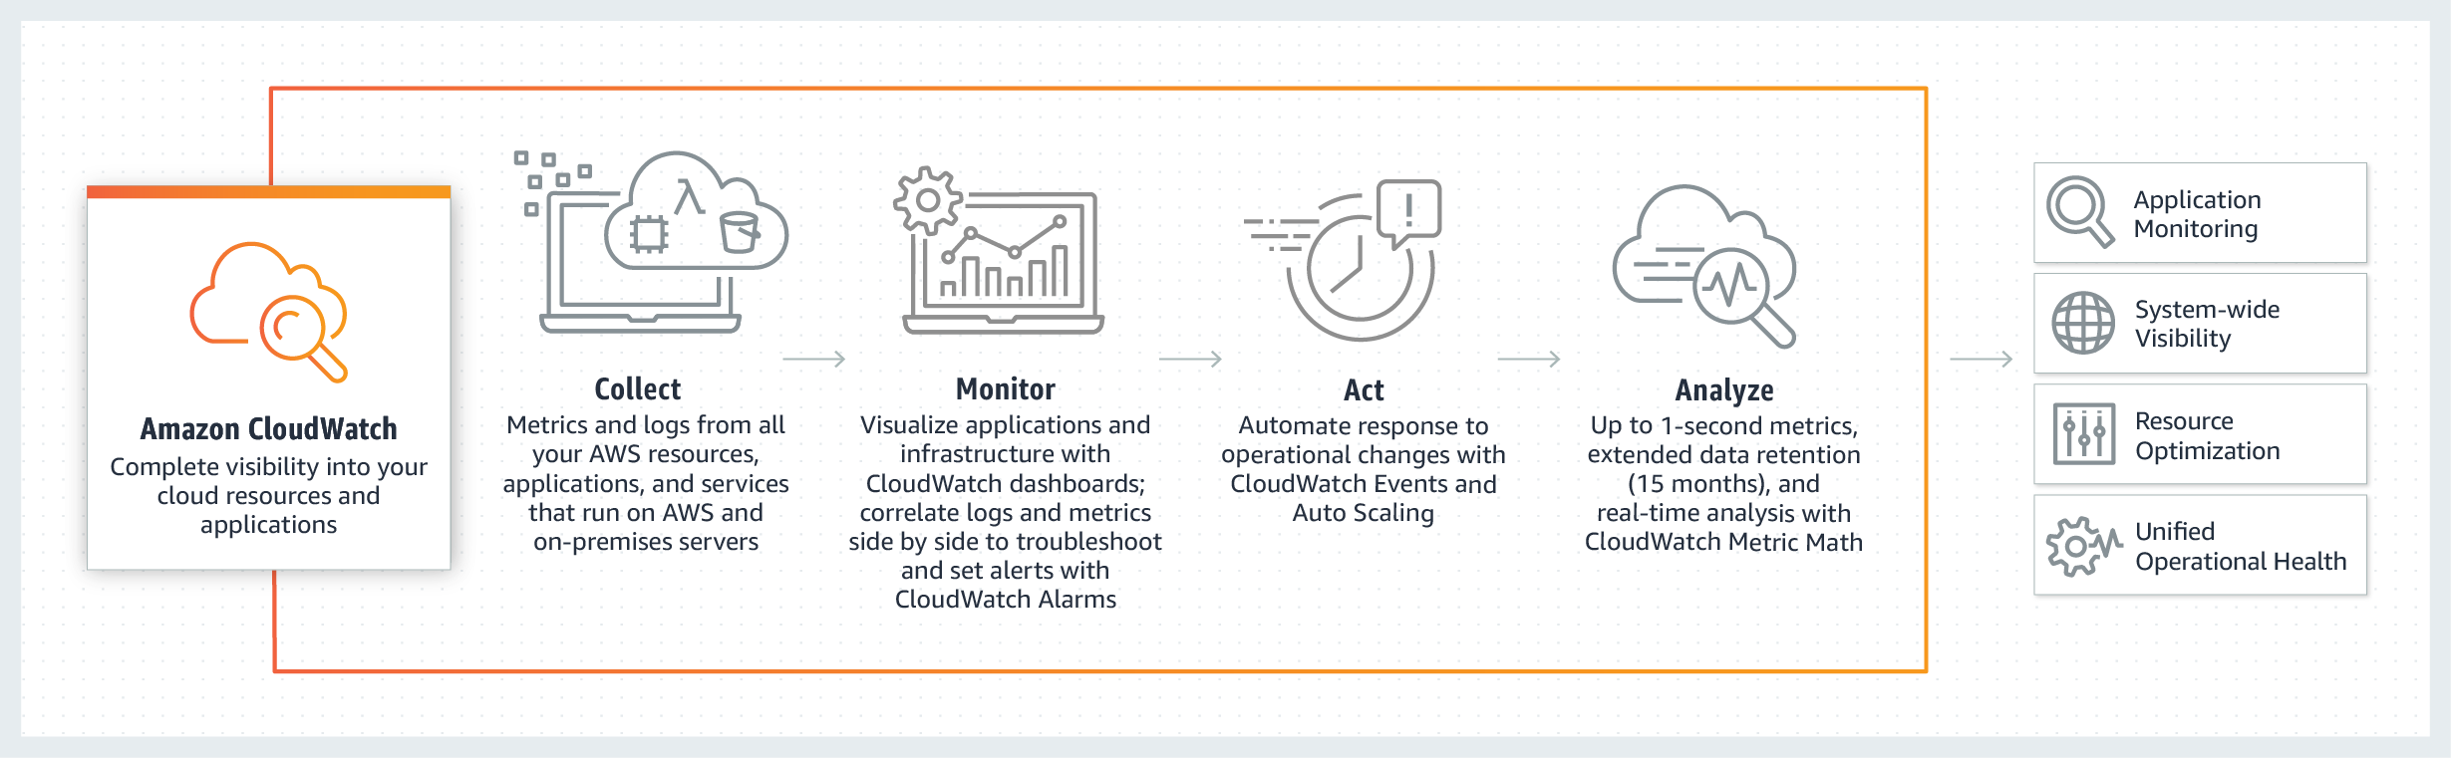
AMAZON ELASTIC CLOUD COMPUTE (EC2) CloudWatch
What is CloudWatch?
CloudWatch collects monitoring and operational data in the form of logs, metrics, and events, providing you with a unified view of AWS resources, applications and services that run on AWS
Collects Standard and Detailed metrices for AWS resources
Standard Monitoring periodically checks the status every 5 minute, Detailed Monitoring collects the status every 1 minute
Dashboards and Alarms can be created. Events can be created for a condition, and can be collected in logs
Notes:
Mounting EFS
If you're using an Amazon Linux EC2 instance, install the EFS mount helper with the following command: sudo yum install -y amazon-efs-utils You can still use the EFS mount helper if you're not using an Amazon Linux instance. Learn more If you're not using the EFS mount helper, install the NFS client on your EC2 instance:
On a Red Hat Enterprise Linux or SUSE Linux instance, use this command: sudo yum install -y nfs-utils
On an Ubuntu instance, use this command: sudo apt-get install nfs-common
Mounting your file system
Open an SSH client and connect to your EC2 instance. (Find out how to connect).
Create a new directory on your EC2 instance, such as "efs". sudo mkdir efs
Mount your file system with a method listed following. If you need encryption of data in transit, use the EFS mount helper and the TLS mount option. Mounting considerations
Using the EFS mount helper: sudo mount -t efs <FS ID>:/ efs

Slide 29
AMAZON ELASTIC CLOUD COMPUTE (EC2) LAB 11
Configure and test CloudWatch Alerts
Create an dashboard
Go to CloudWatch Console > Dashboards
Click on “Create dashboard”, provide a name, then click create
Select and Add a “Line” metric, then click on configure
Select a metric from all metrics
Then click on “Create Widgets”
Add more widgets
Create an Alarm
Go to Alarms
Click on “Create Alarm”
Click on “Select metric”
Select CPUUtilization from All metrics
Fill up the “Alarm details”
Set the trigger as Whenever: CPUUtilisation
Is >=1
For 1 out of 1 datapoints
In in Actions,
Set “Whenever this alarm” to “State is ALARM”
In Send notification to, Click on “New List”
Enter your Email ID
Confirm you email ID
Click on Create Alarm
See if the Alarm is working
Bonus Challenge: Create an Alarm for Billing
Notes:
Mounting EFS
If you're using an Amazon Linux EC2 instance, install the EFS mount helper with the following command: sudo yum install -y amazon-efs-utils You can still use the EFS mount helper if you're not using an Amazon Linux instance. Learn more If you're not using the EFS mount helper, install the NFS client on your EC2 instance:
On a Red Hat Enterprise Linux or SUSE Linux instance, use this command: sudo yum install -y nfs-utils
On an Ubuntu instance, use this command: sudo apt-get install nfs-common
Mounting your file system
Open an SSH client and connect to your EC2 instance. (Find out how to connect).
Create a new directory on your EC2 instance, such as "efs". sudo mkdir efs
Mount your file system with a method listed following. If you need encryption of data in transit, use the EFS mount helper and the TLS mount option. Mounting considerations
Using the EFS mount helper: sudo mount -t efs <FS ID>:/ efs

